Slide 1

Aggregation and Transformation of Vector-Valued Messages in the Shuffle Model of Differential Privacy
Mary Scott, Graham Cormode, Carsten Maple
HALG 2022, Friday 3rd June 2022, LSE

Slide 2
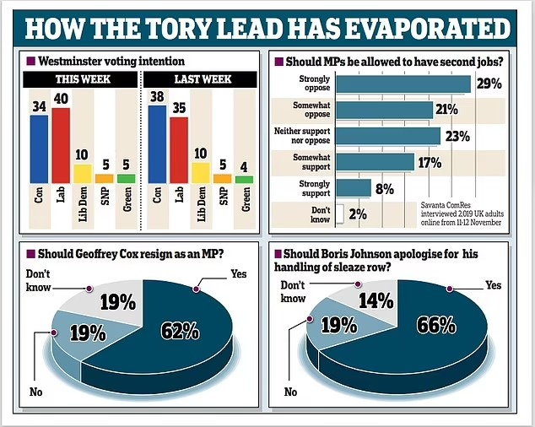
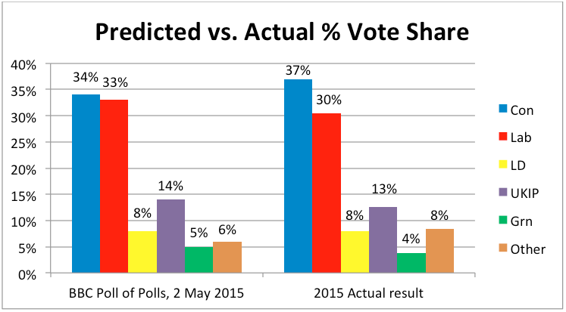
Exit polls

Slide 3
Why is privacy needed?
Political and medical information – highly sensitive data
Vulnerable to attacks to manipulate overall trends

Slide 4
Why is privacy needed?
Political and medical information – highly sensitive data
Vulnerable to attacks to manipulate overall trends
Differential privacy – leading candidate to provide privacy protection
Cannot isolate a particular user’s data from dataset
Cannot determine whether particular user is in dataset
Mathematically strong and has provable guarantees

Slide 5
Models of Differential Privacy
Centralized Model – users send their raw data to central location where noise is added
Have to trust central entity

Slide 6
Models of Differential Privacy
Centralized Model – users send their raw data to central location where noise is added
Have to trust central entity
Local Model – each user adds their own noise before sending their protected data to central location
Untrusted but requires more noise

Slide 7
Models of Differential Privacy
Centralized Model – users send their raw data to central location where noise is added
Have to trust central entity
Local Model – each user adds their own noise before sending their protected data to central location
Untrusted but requires more noise
Shuffle Model – adds extra “shuffling” step to Local Model to unbind each user from their data

Slide 8
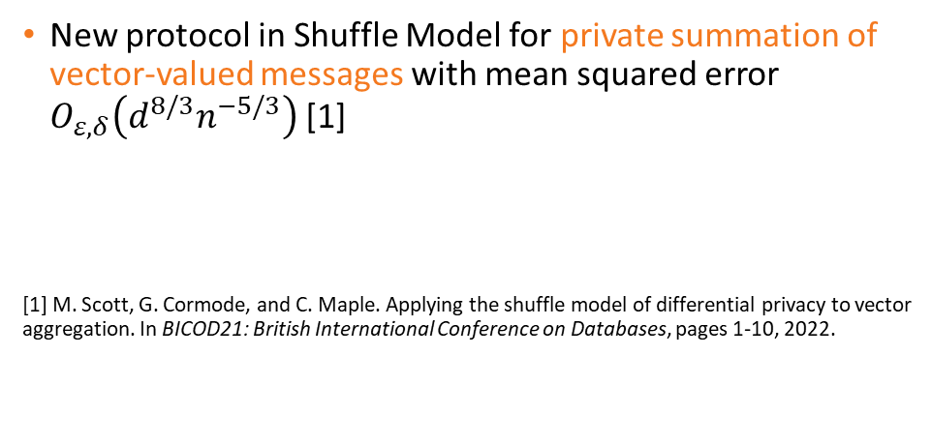
Published work on the Shuffle Model
New protocol in Shuffle Model for private summation of vector-valued messages with mean squared error $O_{ε,δ}\left(d^{8/3}n^{−5/3}\right)$ [1]
Improved bound for private summation protocol with Discrete Fourier Transform with mean squared error $O_{ε,δ}\left(m^{8/3}n^{−5/3}\right)$, $m≪d$ [2]
[1] M. Scott, G. Cormode, and C. Maple. Applying the shuffle model of differential privacy to vector aggregation. In BICOD21: British International Conference on Databases, pages 1-10, 2022.

Slide 9
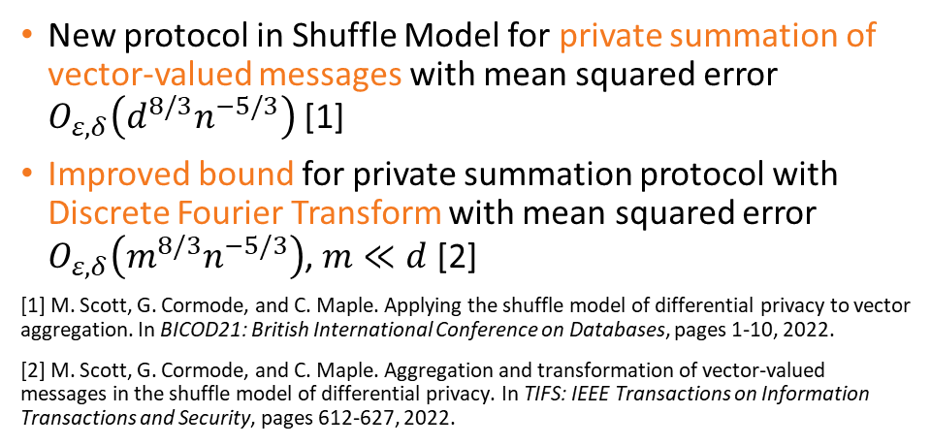
Published work on the Shuffle Model
New protocol in Shuffle Model for private summation of vector-valued messages with mean squared error $O_{ε,δ}\left(d^{8/3}n^{−5/3}\right)$ [1]
Improved bound for private summation protocol with Discrete Fourier Transform with mean squared error $O_{ε,δ}\left(m^{8/3}n^{−5/3}\right)$, $m≪d$ [2]
[1] M. Scott, G. Cormode, and C. Maple. Applying the shuffle model of differential privacy to vector aggregation. In BICOD21: British International Conference on Databases, pages 1-10, 2022.
[2] M. Scott, G. Cormode, and C. Maple. Aggregation and transformation of vector-valued messages in the shuffle model of differential privacy. In TIFS: IEEE Transactions on Information Transactions and Security, pages 612-627, 2022.

Slide 10

Thank you for listening
Visit our poster to find out more
Mary.P.Scott@warwick.ac.uk

